Slide 1
Use Git Like a Pro
https://event.on24.com/eventRegistration/console/apollox/mainEvent?&eventid=4633072
repo: git advanced

Slide 2
Terminology
Repository – The .git folder that does all the file tracking
  If the folder is deleted then all version data is lost
Remote Repository
  pull – Read from the Remote Repository
  push – Write to the Remote Repository
Working directory – Contains the .git directory where the user does the work.
Origin – An alias to the remote repository
Commits – Snapshots of the project taken by git and committed to the local repository
Branch – Current Version of your working Directory stored in the .git folder at a particular point in time
Git Workflow
  Working Directory – Modify the files
  Staging Area – Changes will go into the next commit
  Commit the files
    .git Repository – do a commit. Snapshot is stored directly in the Repo

Slide 3
Notes
git config –global user.name “charles stockman”
git config –global user.email “chuck.stockman@yahoo.com”
Configuration Info in ~/.gitconfig
.gitignore file
  A file with a list of files that will be ignored
Set a property – git config –global user.name Charles Stockman
  Also can set user.email
Staging Area
  git add to add to the staging area
  file to be committed
  Why it's useful
    The staging area gives you fine-grained control over your commits. You can:
    Commit only some changes: Maybe you've modified 5 files but only want to commit 2 of them
    Review before committing:
      git status
      git diff –staged
    Craft logical commits: Group related changes together even if they're scattered across different files
git remote
  git remote add <name> <url>
    name is an alias ex. origin
    url – remote repository
  git remote -v – display the repository for the fetch and push
  git remote <original name> <new name>

Slide 4
Notes
Create a new project
  Create a git repository – git init
    default name of branch is master
    Can change the name of the branch to main – git branch -m main
git status
git push <name>
  Only use name parameter when working with 2 or local repositories in the same workdir
git push –set-upstream <repository name> <branch>
  After running this command once, Git remembers the connection between your local and remote branches.
  Future pushes can simply be git push (no need to specify the remote or branch)
    git pull will know where to pull from
    You can see if your local branch is ahead/behind the remote
git reset . → Moves the changes in the directory from the Staging Area to the Working Directory
git log –one-line → shows the data on one line ( hash, branch, message )

Slide 5
Notes
head – latest commit in the branch
git fetch – pulls the changes from the remote work directory , but does not apply them
  The .git folder is in sync with the .git folder in the remote
  No changes to the working directory
  Main reasons:
    Safe preview - You can see what changes exist on the remote before deciding whether to integrate them. Unlike git pull, it doesn't automatically merge anything into your current work.
    Inspect before merging - After fetching, you can review the remote changes with commands like git log origin/main or git diff origin/main to see exactly what's different before you merge.
    Update your local knowledge - It updates your local copy of remote branches (like origin/main) so you know what's happening in the remote repository, even if you're not ready to merge those changes yet.
    Work with multiple branches - You can fetch all remote branches at once and then choose which ones to merge or checkout, rather than pulling them one at a time.
  Workflow
    git fetch origin
      Download updates from remote git log origin/main
    Review what changed
    git merge origin/main # Merge when ready

Slide 6
Notes
git branch
  git switch branch // Checkout the branch
  git checkout
    git checkout <branch name> // Switch to a branch
    git checkout <file> // Undo changes in a file from the last revision
    git checkout <commit hash> // Move to a commit or tag
      Move to the detached head state
      You have moved away from the branch
      Create a new branch or retain the commits then use git switch -c <branch name>
      Next steps
        can create a new branch ( git switch -c <branch name>)
          Creates and moves to a new branch
Stashing
  location to store temporary changes to a file
  Pushing Files to Stash – git stash push
  Pushing Files to Stash include untracked ( git stash push -u -k )
  Applying Stash: git stash pop ( instead of pop can use apply and the entries will still be in the stash )
  While changes are stashed the file is updated. When popped the changes will be merged into the file
    If your changes will be overwritten the change will not happen ( not able to apply the stash since the changes were in the same file )
    Once you commit the change in the file then do a pop then the changes will need to be merged.

Slide 7
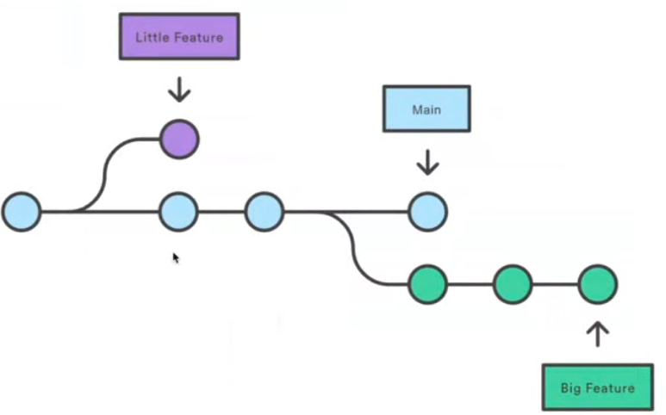
Notes
commit
  git add move from the git working directory to the staging area
  move from the staging area to the .git repository
  git commit –amend -m “New Message” -- changes the commit message of the last commit
  To amend the message of a commit that is already pushed to the remote
    git commit --amend -m "New commit message"
    git push --force origin branch-name
Branches
  An independent line of development consisting of a series of commits
  git branch -D <branch name> -- Deletes a branch
  Type of branches ( only develop and main are long lived )
    feature
    develop – long live branch that contains the development code not pushed to production ( main branch)
    hotfix
    release
    main branch

Slide 8
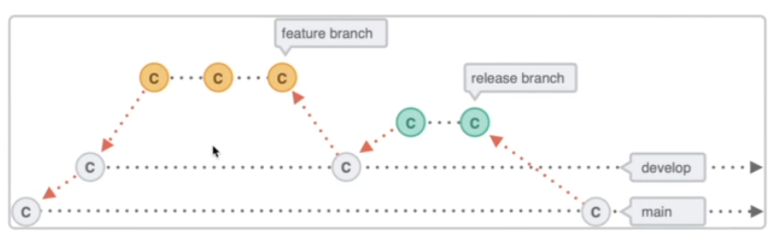
Notes
  Branching Strategies
    Git Flow ( works will where releases are not frequent
      Two long running branches main and develop
      Feature branches are cut from develop and
      merged into develop
      New release branch is cut from develop which is
      tested and bugs are fixed in the same branch
      Merge release branch into main
      Add a tag for the release commit on the main branch
      and delete the release branch
    Github Flow
      Only one long running branch – main
      Cut all branches ( feature, bugfix ) from main
      Merge all features back into main
    Prefixes
      feature/
      bugfix/
      release/
      hotfix/

Slide 9
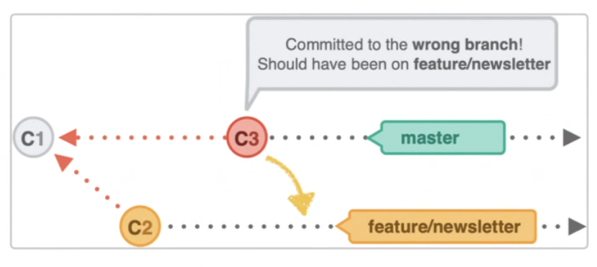
Notes
Change the branch name
  Assumption you are changing the name of the current branch
  git branch -m <new-branch-name> // Change the branch
  For the remote branch
    git push origin <new-branch-name>
    git push origin --delete <old-branch-name>
    git push --set-upstream origin <new-branch-name>
Move commit from one branch to another branch
  git checkout <branch that the commit will be moved to>
  git cherrypick <sha of the commit moving to the current branch>
Rename the current branch git branch -m <new name>
Tags – Typically used to mark release points
  git tag
  git tag -a v1 -m “my first version” -- creates the tag from the current branch
    marks a specific commit
  git show v1

Slide 10
Notes
  git tag <tag-name> <commit-hash> // Create a tag for a specific commit
    ex. git tag v1.2.0 a1b2c3d
  git tag –delete 1
Merging
  How it is done
    Checkout the branch the other branch should be merged into
      Example – Move to develop branch if you want to merge a feature branch
    git merge <branch name>
      git merge feature/user-login
  If there are no conflicts then it should easily fast-forward
  If there are conflicts then git will warn and show in the file where the conflicts are
    A Conflict happens because a file appear and two different version, but there are differences in either or both of the files

Slide 11
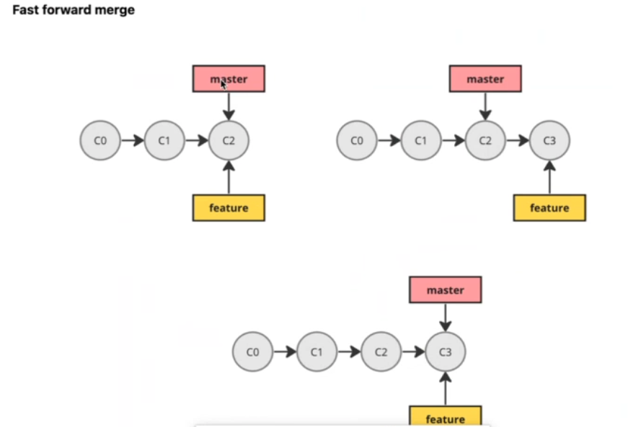
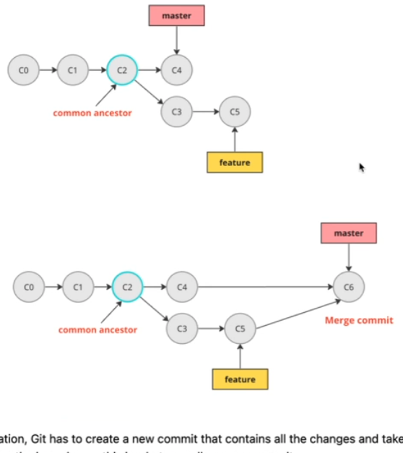
Notes
Fast Forward Merge – A merge with no conflicts
Three Way Merge
  calculates the common ancestor to compare the changes between the two file
  Merge Commit – See picture on the bottom
    Not able to do a Fast Forward Merge since there were changes in common files
    Create a new commit that contains all the changes and takes care of difference between
    the files
git merge –abort – Aborts a merge
Rebase
  Cutting a new base from and applying your changes
  Git takes the commits that exist in your current branch but not in the specified branch,
    temporarily removes them,
    updates your branch to match the target branch,
    then reapplies your commits one by one on top.
  Example where you have master and feature-a
    checkout feature-a
    Take the changes of main branch into feature-a by using rebase
      git rebase main

Slide 12
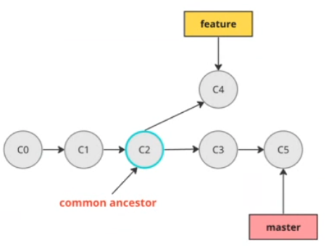
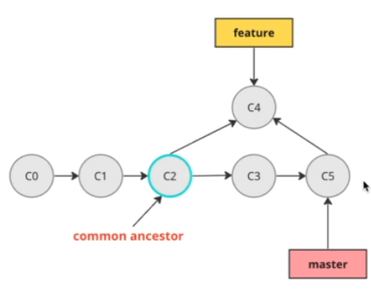
Notes
Using pictures to describe Rebase
  Rebase will apply C4 after C5
  No merge commit so the history is clean
    With merging no also possible to fast-forward
    Rebase gets rid of the merge commit
  Then do git checkout main and git merge feature-A
    No merge commit – The history is clean
People use rebase for a few key reasons:
  Cleaner history
    Rebasing creates a linear commit history without merge commits cluttering up your log.
    Instead of seeing a tangled web of branches merging back and forth, you get a straight line of commits
      much easier to understand when reviewing what happened.
  Easier code review
    When you rebase your feature branch onto the latest main before creating a pull request,
      reviewers see your changes as a clean set of commits on top of the current codebase, without merge commits mixed in.
  Easier debugging Tools like git bisect (which helps find which commit introduced a bug) work much better with linear history.
    If you need to track down when something broke, a clean history makes it significantly faster.
  Staying up-to-date You can regularly rebase your feature branch onto main to incorporate the latest changes from the team rather than creating merge commits every time you want to sync up.
    This keeps your branch current while maintaining clean history.
  Cleaning up your work Interactive rebase (git rebase -i) lets you reorganize, combine, edit, or delete commits before sharing them.
    You might squash "fix typo" commits into the original commit, reorder commits logically, or rewrite commit messages.
When teams prefer merge instead: Some teams actually prefer merge commits because they preserve the exact history of what happened and when branches diverged. It's often a team/project preference whether to use rebase or merge workflows.

Slide 13
Notes
Rebase
  Inside a branch other than main
    git rebase main
    update the branch with changes in main
  Git rebase is a way to move or combine a sequence of commits to a new base commit. It essentially rewrites your commit history by replaying your changes on top of another branch.
  Here's what happens when you rebase:
    Say you're on a feature branch and you run git rebase main. Git will:
    Find the common ancestor between your branch and main
    Temporarily save all your commits since that ancestor
    Reset your branch to point to the tip of main
    Replay each of your saved commits one by one on top of main
    The main difference from merging is that rebase creates a linear history instead of creating a merge commit. Your commits get "moved" to appear as if you started working from the latest version of the base branch.
  Common uses:
    git rebase main - Update your feature branch with the latest changes from main
    git rebase -i HEAD~3 - Interactive rebase to edit, squash, or reorder your last 3 commits
  Important caveat: Never rebase commits that you've already pushed and that other people might be working from, since rebase rewrites history. This can cause serious problems for collaborators.
  Some people prefer rebasing for a cleaner history, while others prefer merging to preserve the true development timeline. Both approaches work fine.

Slide 14
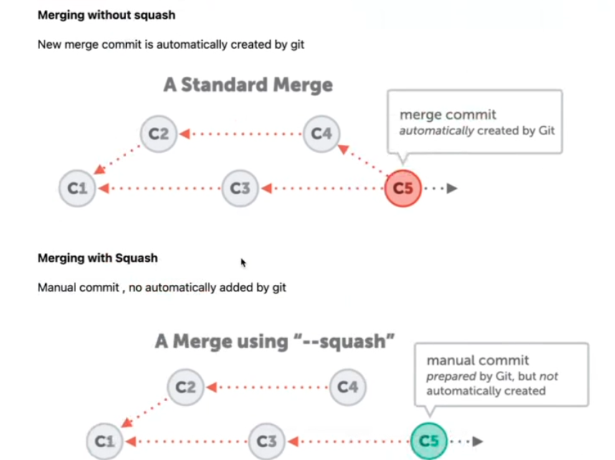
Notes
Squashing
  To keep history clean keep all commits into a single commit
  1st solution
    git rebase -i Head~3
    will provide a git comment where the top lines have pick
    For each one you want to change to squash change pick to squash
    The rest is a comment that you can change
  2nd Solution
    Use git merge –squash feature/authentication
Interactive Rebase
  Usage
    Change Commit Message
    combine multiple commits
    split and edit existing files
    reorder commits
    delete commits

Slide 15
Notes
amend message
  git –amend <new message> only top level commit
  using interactive rebase
    git rebase -i <sha of one commit before>
    A git commit message will appear and select the pick of the message
      replace it with reword and save
      change the commit message
  Delete a commit
    git rebase -i <sha of one commit before>
    change pick to drop
  git rebase –abort
aliases
  set in .git.config

